Slide 1
Introduction to Graph Analytics SEAS 6401 Introduction to Data Science
Benjamin S. Harvey

Slide 2
Outline
Graph structured data
Common properties of graph data
Graph algorithms
Systems for large-scale graph computation
GraphX: Graph Computation in Spark
Summary of other graph frameworks

Slide 3
Graph structured data is everywhere …

Slide 4

Social Network
Vertices
Users
Posts / Images
Edges
Social Relationships
Directed: Twitter
Undirected: Facebook
Likes

Slide 5
Actual Social Graph
Karate Club Network

Slide 6
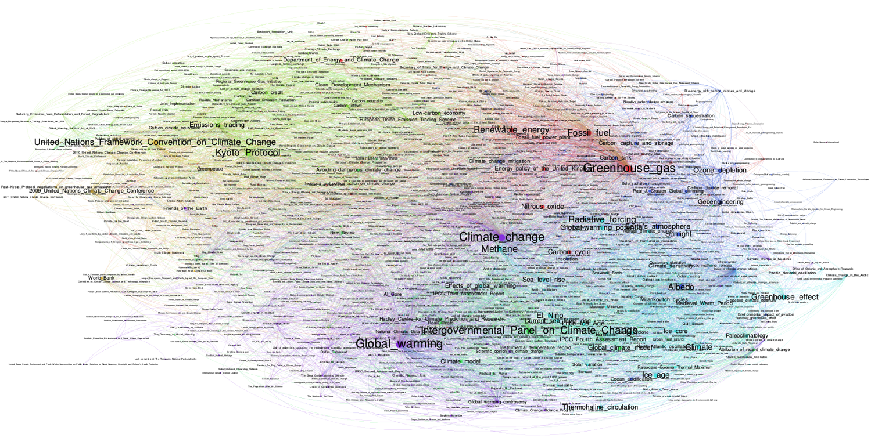
Web Graphs
Wikipedia restricted to 1000 climate change pages
Vertices: Web-pages
Edges: Links (Directed)
Generated Content:
Click-streams
Notes:
Image due to: http://www.emapsproject.com/blog/archives/1572

Slide 7
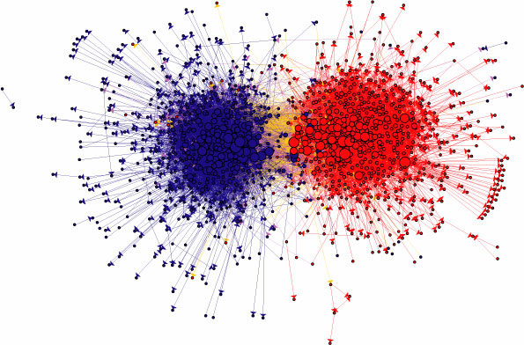
Web Graphs
2004 Political Blogs
Vertices: Web-pages
Edges: Links (Directed)
Generated Content:
Click-streams
Notes:
Image due to: http://www.emapsproject.com/blog/archives/1572

Slide 8
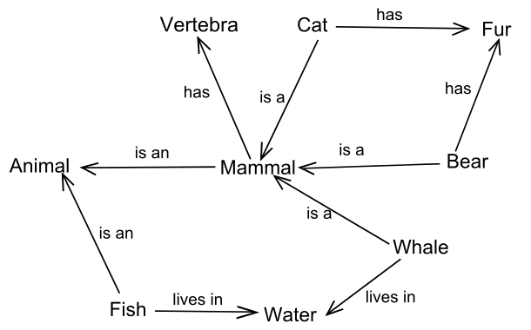
Semantic Networks
Organize Knowledge
Vertices: Subject, Object
Edges: Predicates
Example: Google Knowledge Graph
570M Vertices
18B Edges
http://wiki.dbpedia.org
Notes:
http://www.google.com/insidesearch/features/search/knowledge.html
http://www.w3.org/Talks/2002/10/16-sw/slide7-0.html

Slide 9
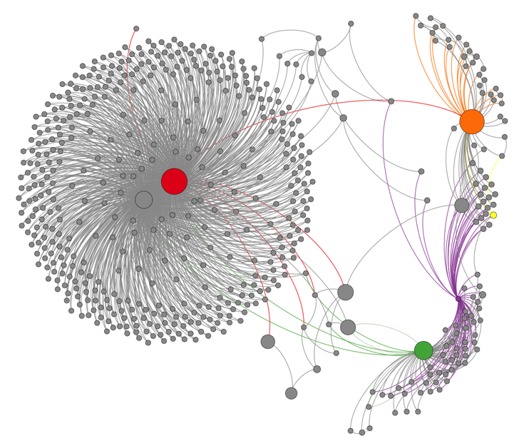
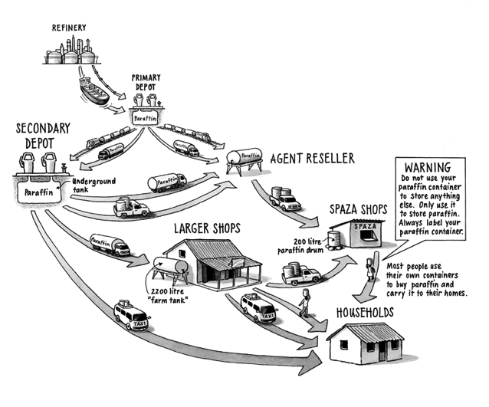
Transaction Networks
Supply Chain:
Vertices: Suppliers/Consumers
Edges: Exchange of Goods
Transaction Networks (e.g., Bitcoin):
Vertices: Users
Edges: Exchange of Currency
http://anonymity-in-bitcoin.blogspot.com/2011/07/bitcoin-is-not-anonymous.html
Notes:
Supply chain image due to: http://www.hedon.info/BP56:HouseholdEnergyPovertyAndParaffinInSouthAfrica
Bitcoin network: http://anonymity-in-bitcoin.blogspot.com/2011/07/bitcoin-is-not-anonymous.html

Slide 10
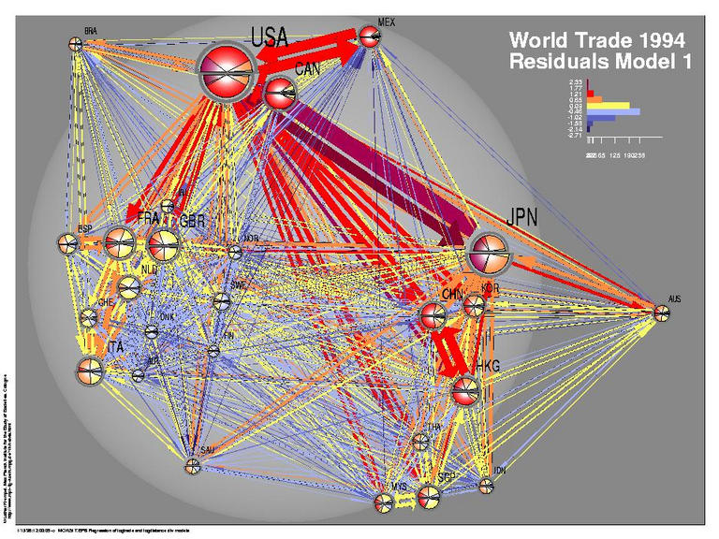
Transaction Networks
Supply Chain:
Vertices: Suppliers/Consumers
Edges: Exchange of Goods
Transaction Networks (e.g., Bitcoin):
Vertices: Users
Edges: Exchange of Currency
Notes:
Supply chain image due to: http://www.hedon.info/BP56:HouseholdEnergyPovertyAndParaffinInSouthAfrica
http://www.cmu.edu/joss/content/articles/volume4/KrempelPlumper.html

Slide 11
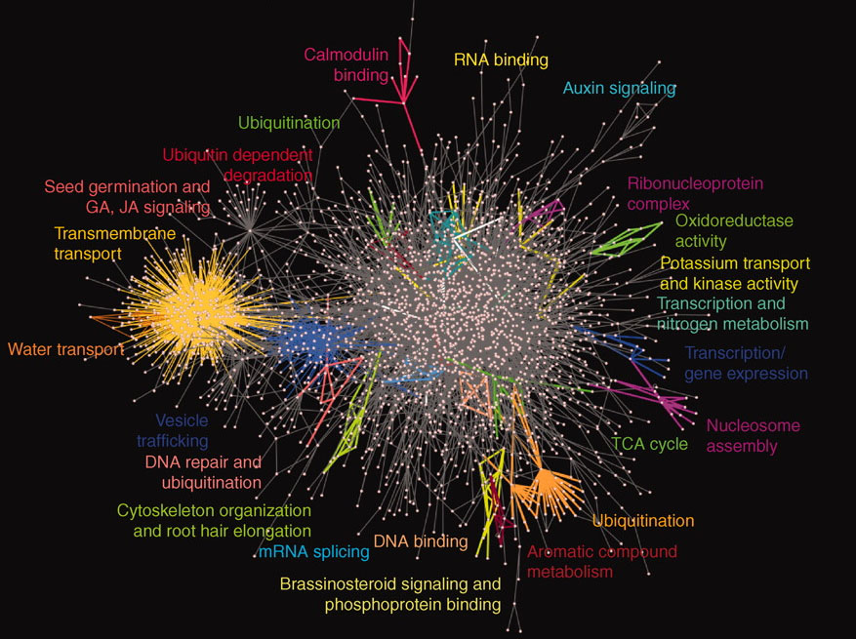
Biological Networks
Protein-Protein Interaction Networks (Interactomes)
Vertices: Proteins
Edges: Interactions
Notes:
http://www.opencb.org/sites/opencb.org/files/bigdata_viz.jpg

Slide 12
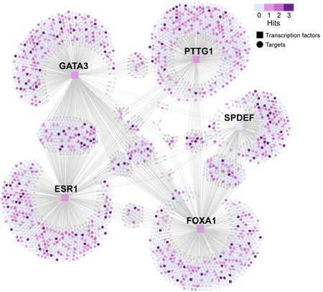
Biological Networks
Regulatory Networks (Bipartite)
Vertices: Regulators, targets
Edges: Regulates target
Notes:
http://www.nature.com/nature/journal/v478/n7367/fig_tab/nature10423_F1.html

Slide 13
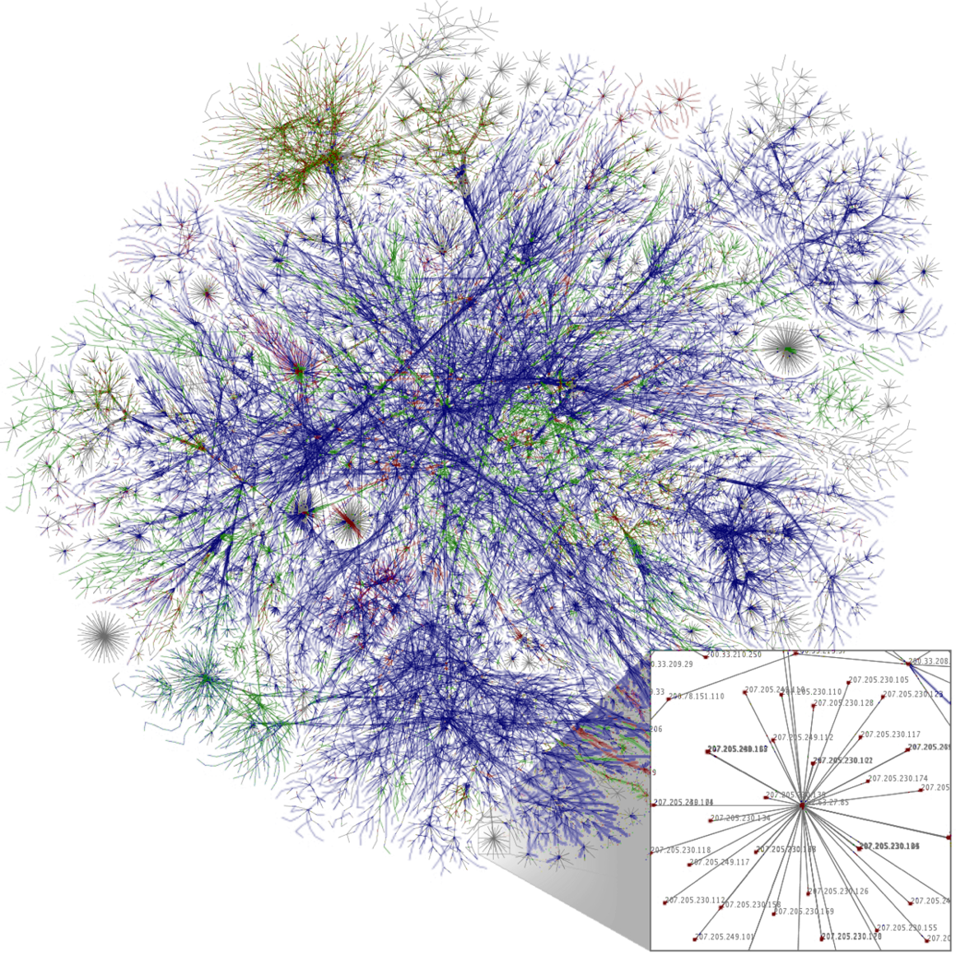
Communication Networks
Email
Call records
Vertices: Devices, Routers
Directed Edges: Network Flows
Notes:
http://www.math.cornell.edu/~mec/Winter2009/RalucaRemus/Lecture2/lecture2.html
http://en.wikipedia.org/wiki/Internet

Slide 14
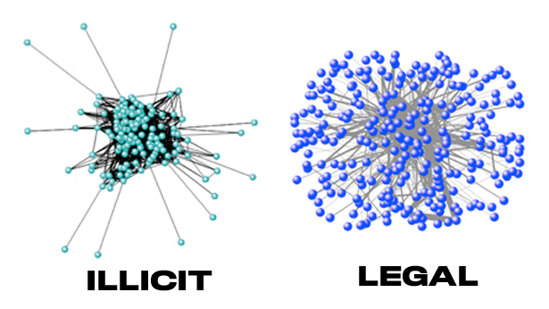
Who Talks to Whom Graph
Enron Email Graphs
Vertices: Users
Directed Edges: Email From→To
Notes:
Enron Email Graph: https://www.sciencenews.org/article/information-flow-can-reveal-dirty-deeds

Slide 15
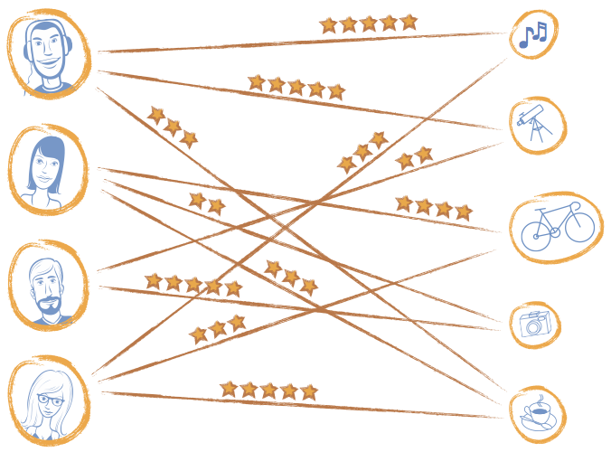
User - Item Graphs (Recommender Systems)
Bipartite Graphs
Vertices: Users and Items
Edges: Ratings
Notes:
Image from www.graphlab.com

Slide 16

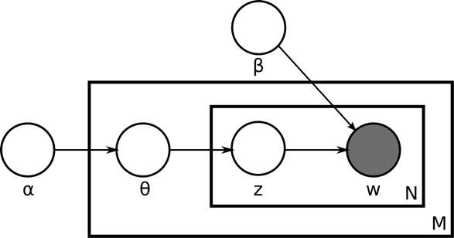


Graphical Models
Vertices: Random Variables, Factors
Edges: Statistical Dependencies
Cat
Apple
Growth
Hat
LDA
Plant
Notes:
Image due to http://commons.wikimedia.org/wiki/File:Latent_Dirichlet_allocation.svg

Slide 17
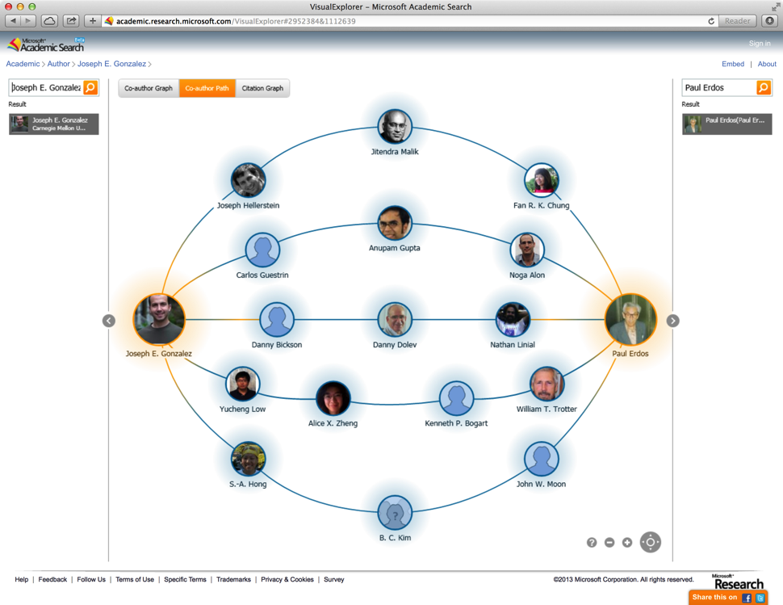
Co-Authorship Network
Vertices: Authors
Edges: Co-authorship
http://academic.research.microsoft.com/VisualExplorer#2952384&1112639
Example: Erdos Number
Notes:
http://academic.research.microsoft.com/VisualExplorer#2952384&1112639

Slide 18
Others?

Slide 19
Common properties of graphs derived from natural phenomena

Slide 20
Power-Law Degree Distribution
More than 10⁸ vertices have one neighbor.
High-Degree
Vertices
Top 1% of vertices are adjacent to
50% of the edges!
-Slope = α ≈ 2
Number of Vertices
AltaVista WebGraph
1.4B Vertices, 6.6B Edges
Degree

Slide 21
Giant Connected Component

Slide 22
Densification
US Patent Citations
Average distance between nodes reduces over time.
Notes:
Citation: http://www.cs.cmu.edu/~jure/pubs/powergrowth-tkdd.pdf

Slide 23
Community Structure
Linked-In
Messenger
Notes:
Figures from: http://arxiv.org/abs/0810.1355

Slide 24
Graph Algorithms “Think Globally, Act Locally”

Slide 25
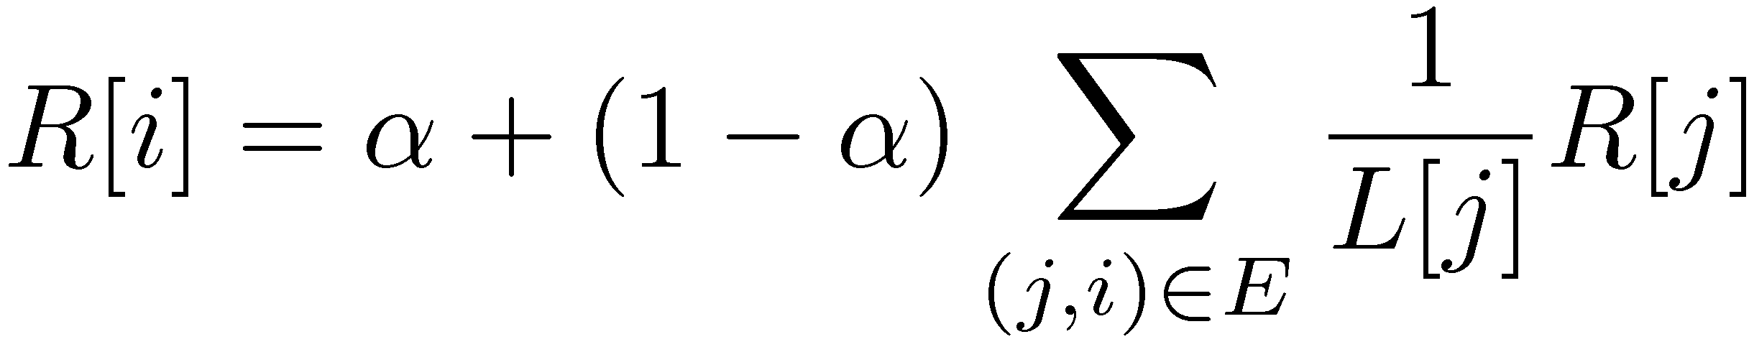
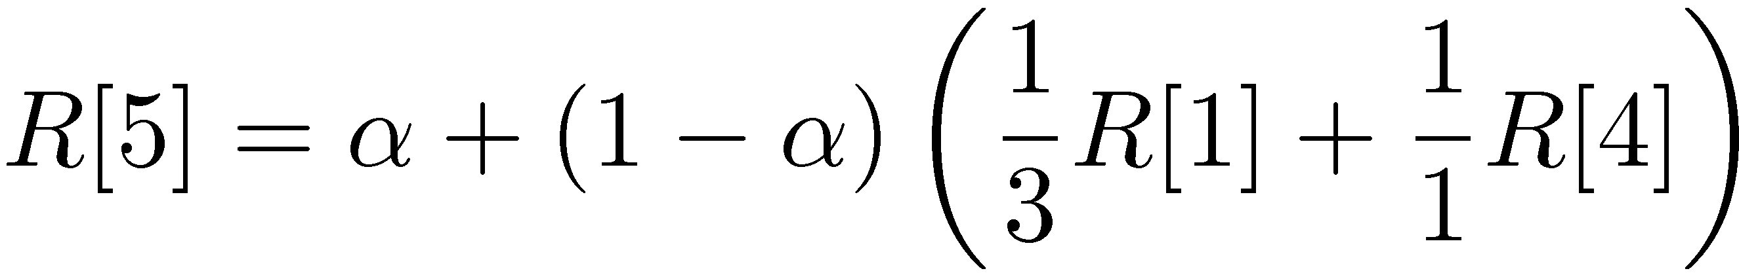
PageRank (Centrality Measures)
Recursive Relationship:
Where:
α is the random reset probability (typically 0.15)
L[j] is the number of links on page j
1
2
3
4
5
6
Notes:
http://ilpubs.stanford.edu:8090/422/1/1999-66.pdf

Slide 26



Predicting Behavior
?
?
Liberal
Conservative
?
?
?
?
?
?
?
?
Post
?
Post
?
Post
Post
?
Post
Post
Post
Post
?
Post
Post
Post
Post
?
Post
?
Post
?
?
?
?
?
Post
?
Post
Post
Post
Post
Post
Post
?
Post
?
?
?
?
?
?
?

Slide 27
Mean Field Algorithm
X₃
X₂
Y₃
Post
Sum over Neighbors
X₁
Post
Y₂
Y₁
Post

Slide 28




Label Propagation (Structured Prediction)
Sue Ann
Social Arithmetic:
Recurrence Algorithm:
iterate until convergence
80% Cameras
20% Biking
40%
50% What I list on my profile
40% Sue Ann Likes
10% Carlos Like
+
Profile
50%
50% Cameras
50% Biking
I Like:
60% Cameras, 40% Biking
Dave
Carlos
10%
30% Cameras
70% Biking

Slide 29










Recommending Products
Users
Ratings
Items

Slide 30
Recommending Products
Low-Rank Matrix Factorization:
f(3)
r₁₃
Movies
f(1)
Netflix
≈
x
Users
Users
f(j)
r₁₄
f(4)
f(i)
User Factors (U)
Movie Factors (M)
r₂₄
f(2)
Movies
r₂₅
f(5)
Iterate:

Slide 31
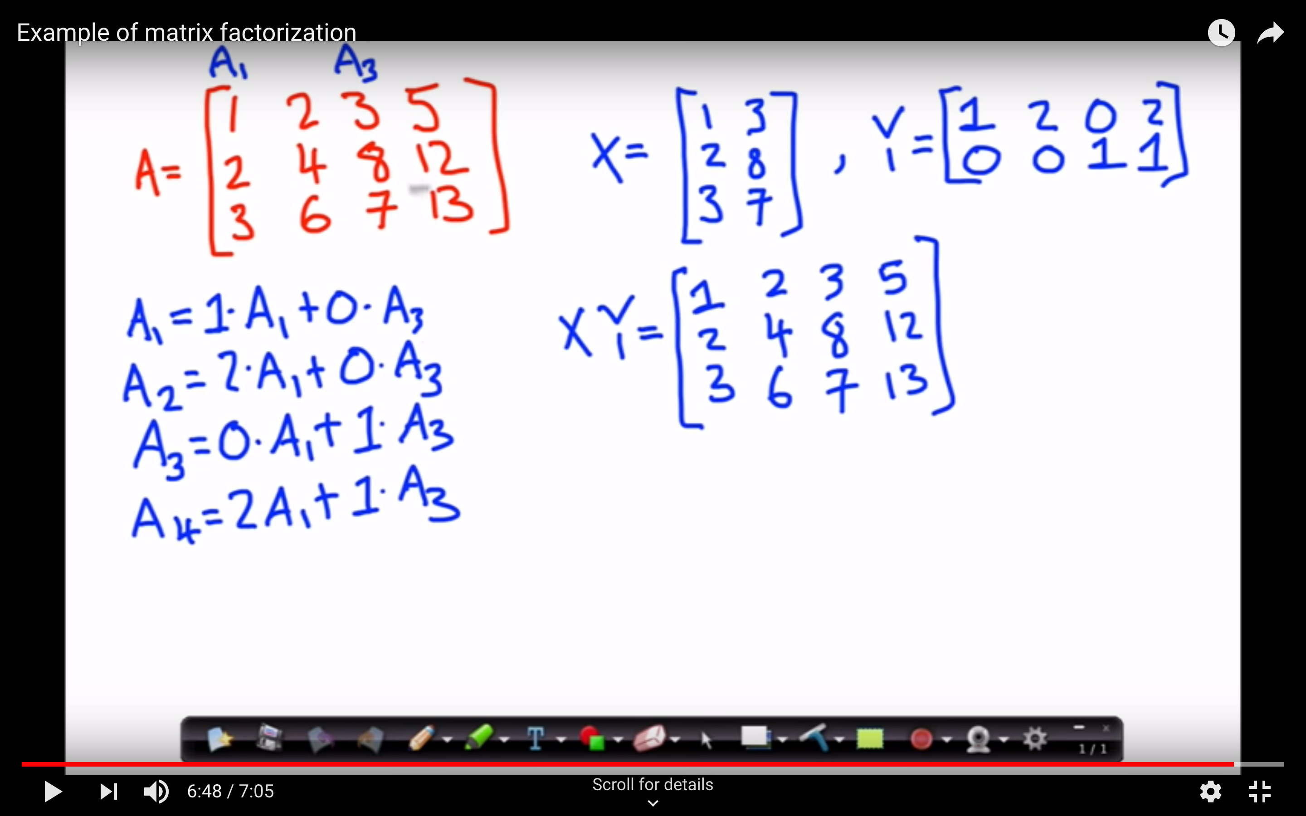

Slide 32
Finding Communities
Count triangles passing through each vertex:
Measure “cohesiveness” of local community
2
3
1
4
2 * #Triangles[i]
Deg[i] * (Deg[i] – 1)
ClusterCoeff[i] =

Slide 33
Counting Triangles
Count triangles passing through each vertex by counting triangles on each edge:
E
C
B
A
1
C
A
B
C
C
D
2
D
D
E
D
G
F
F
G

Slide 34
Connected Components
Every vertex starts out with a unique component id (typically it’s vertex id):
1
5
1
4
1
4
2
4
1
4
1
4
3
6
2
4
1
4

Slide 35
Putting it All Together
Hyperlinks
PageRank
Top 20 Pages
Raw
Wikipedia
Text
Table
Title
PR
< / >
Title
Body
Term-Doc
Graph
Topic Model
(LDA)
< / >
< / >
Word Topics
XML
Word
Topic
Discussion
Table
Community
Detection
User
Community
Community
Topic
Editor Graph
User
Disc.
User
Com.
Topic
Com.

Slide 36
Many Other Graph Algorithms
Collaborative Filtering
Alternating Least Squares
Stochastic Gradient Descent
Tensor Factorization
Structured Prediction
Loopy Belief Propagation
Max-Product Linear Programs
Gibbs Sampling
Semi-supervised ML
Graph SSL
CoEM
Community Detection
Triangle-Counting
K-core Decomposition
K-Truss
Graph Analytics
PageRank
Personalized PageRank
Shortest Path
Graph Coloring
Classification
Neural Networks

Slide 37
The Graph-Parallel Pattern
Model / Alg.
State
Fundamental Pattern

Slide 38


Graph-Parallel Systems
Pregel
Expose specialized APIs to simplify graph programming.

Slide 39
The Vertex Program Abstraction
Vertex-Programs interact by sending messages.
Pregel_PageRank(i, messages) :
// Receive all the messages
total = 0
foreach( msg in messages) :
total = total + msg
// Update the rank of this vertex
R[i] = 0.15 + total
// Send new messages to neighbors
foreach(j in out_neighbors[i]) :
Send msg(R[i]) to vertex j
i
Malewicz et al. [PODC’09, SIGMOD’10]

Slide 40
Iterative Bulk Synchronous Execution
Compute
Communicate
Barrier
Notes:
Put equation on slide

Slide 41
Graph-Parallel Systems
Pregel
Exploit graph structure to achieve orders-of-magnitude performance gains over more general data-parallel systems.

Slide 42
Graph System Optimizations
Specialized Data-Structures
Vertex-Cuts
Partitioning
Remote
Caching / Mirroring
Message Combiners
Active Set Tracking
Notes:
----- Meeting Notes (10/3/14 09:56) -----
Graph System Optimizations
Make more crisp vertex-cut to mirror transition
The Price we paid to do this was a specialized system. The question is how to make these optimizations work in a generalized.

Slide 43
GraphLab
(PowerGraph, OSDI’12)
Program This
Run on This
Machine 1
Machine 2
Split High-Degree vertices
New Abstraction → Equivalence on Split Vertices

Slide 44
GAS Decomposition
Machine 1
Machine 2
Master
Gather
Y’
Y’
Y’
Y’
Σ₁
Σ
Σ₂
+ + +
Mirror
Apply
Y
Y
Y
Y
Machine 3
Machine 4
Scatter
Σ₃
Σ₄
Mirror
Mirror

Slide 45
2D Partitioning
v_{i}
Vertices
1
2
2
3
4
Adj.
Matrix
16 Machines
v_{i}
5
6
7
8
5
6
7
8
v_{i} only has neighbors on
7 machines
Vertices
9
10
10
11
12
13
14
14
15
16

Slide 46
Minimizing Communication in PowerGraph
Vertex Cut
Communication is linear in the number of machines each vertex spans.
Y
Y
Y
Total communication upper bound:

Slide 47
Shrinking Working Sets
PageRank on Web Graph
51% of vertices run only once!

Slide 48
The GraphLab (Pull) Abstraction
Vertex Programs directly access adjacent vertices and edges
GraphLab_PageRank(i)
// Compute sum over neighbors
total = 0
foreach( j in neighbors(i)):
total = total + R[j] * w_{ji}
// Update the PageRank
R[i] = 0.15 + total
R[4] * w₄₁
GraphLab_PageRank(i)
// Compute sum over neighbors
total = 0
foreach( j in neighbors(i)):
total = total + R[j] * w_{ji}
// Update the PageRank
R[i] = 0.15 + total
// Trigger neighbors to run again
if R[i] not converged then
signal nbrsOf(i) to be recomputed
4
+
1
R[3] * w₃₁
R[2] * w₂₁
+
3
2
Trigger computation only when necessary.

Slide 49
PageRank on the Live-Journal Graph
GraphLab is 60x faster than Hadoop
GraphLab is 16x faster than Spark

Slide 50
Triangle Counting on Twitter
40M Users, 1.4 Billion Links
Counted: 34.8 Billion Triangles
Hadoop [WWW’11]
1536 Machines
423 Minutes
64 Machines
15 Seconds
1000 x Faster
GraphLab
S. Suri and S. Vassilvitskii, “Counting triangles and the curse of the last reducer,” WWW’11

Slide 51
Graph Analytics Pipeline
Hyperlinks
PageRank
Top 20 Pages
Raw
Wikipedia
Text
Table
Title
PR
< / >
Title
Body
Term-Doc
Graph
Topic Model
(LDA)
< / >
< / >
Word Topics
XML
Word
Topic
Discussion
Table
Community
Detection
User
Community
Community
Topic
Editor Graph
User
Disc.
User
Com.
Topic
Com.

Slide 52
Tables
Hyperlinks
PageRank
Top 20 Pages
Raw
Wikipedia
Text
Table
Title
PR
< / >
Title
Body
Term-Doc
Graph
Topic Model
(LDA)
< / >
< / >
Word Topics
XML
Word
Topic
Discussion
Table
Community
Detection
User
Community
Community
Topic
Editor Graph
User
Disc.
User
Com.
Topic
Com.

Slide 53
Graphs
Hyperlinks
PageRank
Top 20 Pages
Raw
Wikipedia
Text
Table
Title
PR
< / >
Title
Body
Term-Doc
Graph
Topic Model
(LDA)
< / >
< / >
Word Topics
XML
Word
Topic
Discussion
Table
Community
Detection
User
Community
Community
Topic
Editor Graph
User
Disc.
User
Com.
Topic
Com.

Slide 54
Separate Systems
Tables
Graphs

Slide 55


Separate Systems
Dataflow Systems
Graphs
Table
Row
Row
Result
Row
Row

Slide 56

Separate Systems
Dataflow Systems
Graph Systems
Pregel
Table
Dependency Graph
Row
Row
Result
Row
Row
Notes:
Add list of papers to bottom of slide

Slide 57
Separate systems for each view can be difficult to use and inefficient

Slide 58



Difficult to Program and Use
Users must Learn, Deploy, and Manage multiple systems
Leads to brittle and often complex interfaces

Slide 59



Inefficient
Extensive data movement and duplication across the network and file system
< / >
< / >
< / >
XML
HDFS
HDFS
HDFS
HDFS
Limited reuse internal data-structures across stages

Slide 60
The GraphX Unified Approach
New API
Blurs the distinction between Tables and Graphs
New System
Combines Data-Parallel Graph-Parallel Systems
Enabling users to easily and efficiently express the entire graph analytics pipeline

Slide 61
Representation
Join
Dataflow
Operators
Distributed
Graphs
Horizontally
Partitioned Tables
Vertex
Programs
Optimizations
Advances in Graph Processing Systems
Distributed Join Optimization
Materialized View Maintenance

Slide 62
View a Graph as a Table
Vertex Property Table
Property Graph
Id
Rxin
Jegonzal
Franklin
Istoica
Property (V)
(Stu., Berk.)
(PstDoc, Berk.)
(Prof., Berk)
(Prof., Berk)
R
F
Edge Property Table
SrcId | DstId
rxin | jegonzal
franklin | rxin
istoica | franklin
franklin | jegonzal
Property (E)
Friend
Advisor
Coworker
PI
J
I

Slide 63
Spark Table Operators
Table (RDD) operators are inherited from Spark:
map
filter
groupBy
sort
union
join
leftOuterJoin
rightOuterJoin
reduce
count
fold
reduceByKey
groupByKey
cogroup
cross
zip
sample
take
first
partitionBy
mapWith
pipe
save
...

Slide 64
Graph Operators (Scala)
class Graph [ V, E ] {
def Graph(vertices: Table[ (Id, V) ],
edges: Table[ (Id, Id, E) ])
// Table Views -----------------
def vertices: Table[ (Id, V) ]
def edges: Table[ (Id, Id, E) ]
def triplets: Table [ ((Id, V), (Id, V), E) ]
// Transformations ------------------------------
def reverse: Graph[V, E]
def subgraph(pV: (Id, V) => Boolean,
pE: Edge[V,E] => Boolean): Graph[V,E]
def mapV(m: (Id, V) => T ): Graph[T,E]
def mapE(m: Edge[V,E] => T ): Graph[V,T]
// Joins ----------------------------------------
def joinV(tbl: Table [(Id, T)]): Graph[(V, T), E ]
def joinE(tbl: Table [(Id, Id, T)]): Graph[V, (E, T)]
// Computation ----------------------------------
def mrTriplets(mapF: (Edge[V,E]) => List[(Id, T)], reduceF: (T, T) => T): Graph[T, E]
}
Notes:
Make mrTriplets more visible.
Emphasize how this API blurs distinction between graphs and tables

Slide 65
Graph Operators (Scala)
class Graph [ V, E ] {
def Graph(vertices: Table[ (Id, V) ],
edges: Table[ (Id, Id, E) ])
// Table Views -----------------
def vertices: Table[ (Id, V) ]
def edges: Table[ (Id, Id, E) ]
def triplets: Table [ ((Id, V), (Id, V), E) ]
// Transformations ------------------------------
def reverse: Graph[V, E]
def subgraph(pV: (Id, V) => Boolean,
pE: Edge[V,E] => Boolean): Graph[V,E]
def mapV(m: (Id, V) => T ): Graph[T,E]
def mapE(m: Edge[V,E] => T ): Graph[V,T]
// Joins ----------------------------------------
def joinV(tbl: Table [(Id, T)]): Graph[(V, T), E ]
def joinE(tbl: Table [(Id, Id, T)]): Graph[V, (E, T)]
// Computation ----------------------------------
def mrTriplets(mapF: (Edge[V,E]) => List[(Id, T)], reduceF: (T, T) => T): Graph[T, E]
}
capture the Gather-Scatter pattern from
specialized graph-processing systems
def mrTriplets(mapF: (Edge[V,E]) => List[(Id, T)], reduceF: (T, T) => T): Graph[T, E]
Notes:
.

Slide 66
Triplets Join Vertices and Edges
The triplets operator joins vertices and edges:
Vertices
Triplets
Edges
A
A
A
A
B
B
B
B
A
C
A
C
C
B
C
B
C
D
C
D
C
D

Slide 67
Map-Reduce Triplets
Map-Reduce triplets collects information about the neighborhood of each vertex:
Src. or Dst.
MapFunction( ) → (B, )
Reduce
A
B
(B, )
MapFunction( ) → (C, )
A
C
(C, + )
MapFunction( ) → (C, )
B
C
(D, )
MapFunction( ) → (D, )
C
D
Message
Combiners

Slide 68
Using these basic GraphX operators we implemented Pregel and GraphLab in under 50 lines of code!

Slide 69
The GraphX Stack (Lines of Code)
PageRank (20)
Connected Comp. (20)
K-core
(60)
Triangle
Count
(50)
LDA
(220)
SVD++
(110)
Pregel API (34)
GraphX (2,500)
Spark (30,000)
Some algorithms are more naturally expressed
using the GraphX primitive operators
Notes:
The simple set of GraphX operators are capable of expressing not only existing graph processing systems but can also be more convenient to express certain graph algorithms directly.

Slide 70
We express enhanced Pregel and GraphLab abstractions using the GraphX operators in less than 50 lines of code!

Slide 71
Enhanced Pregel in GraphX
Require Message Combiners
pregelPR(i, messageList ):
messageSum
// Receive all the messages
total = 0
foreach( msg in messageList) :
total = total + msg
messageSum
// Update the rank of this vertex
R[i] = 0.15 + total
combineMsg(a, b):
// Compute sum of two messages
return a + b
Remove Message Computation from the
Vertex Program
// Send new messages to neighbors
foreach(j in out_neighbors[i]) :
Send msg(R[i]/E[i,j]) to vertex
sendMsg(i→j, R[i], R[j], E[i,j]):
// Compute single message
return msg(R[i]/E[i,j])
Malewicz et al. [PODC’09, SIGMOD’10]

Slide 72
GraphX System Design

Slide 73
Distributed Graphs as Tables (RDDs)
Vertex Table (RDD)
Routing
Table (RDD)
Edge Table
(RDD)
Property Graph
Part. 1
A
B
B
A
A
1
2
B
C
C
A
C
B
B
1
B
C
C
D
A
A
A
D
D
D
C
C
1
2D Vertex Cut Heuristic
A
D
Part. 2
A
E
D
D
1
2
A
F
F
F
E
E
E
E
2
E
D
F
F
2
E
F

Slide 74
Caching for Iterative mrTriplets
Vertex Table (RDD)
Edge Table
(RDD)
Mirror
Cache
A
B
A
A
A
A
A
C
B
B
B
B
C
C
D
C
D
C
C
Mirror
Cache
A
E
D
D
D
A
A
F
E
D
E
E
D
E
F
F
F
E
F

Slide 75
Incremental Updates for Iterative mrTriplets
Vertex Table (RDD)
Edge Table
(RDD)
Mirror
Cache
A
B
Change
A
A
A
A
A
C
B
B
B
C
C
D
C
D
C
Mirror
Cache
A
E
D
A
A
F
D
Change
E
Scan
E
E
D
E
F
F
E
F

Slide 76
Aggregation for Iterative mrTriplets
Vertex Table (RDD)
Edge Table
(RDD)
Mirror
Cache
A
B
Change
A
A
A
C
Local
Aggregate
B
B
Change
B
B
C
C
C
D
C
D
Change
C
Mirror
Cache
A
E
Change
D
A
A
F
Local
Aggregate
D
E
Scan
Change
D
E
D
E
Change
F
F
F
E
F

Slide 77
Performance Comparisons
Live-Journal: 69 Million Edges
GraphX is roughly 3x slower than GraphLab

Slide 78
GraphX scales to larger graphs
Twitter Graph: 1.5 Billion Edges
GraphX is roughly 2x slower than GraphLab
Scala + Java overhead: Lambdas, GC time, …
No shared memory parallelism: 2x increase in comm.

Slide 79
PageRank is just one stage…. What about a pipeline?

Slide 80
A Small Pipeline in GraphX
Raw Wikipedia
Hyperlinks
PageRank
Top 20 Pages
< / >
< / >
< / >
HDFS
HDFS
XML
Spark Preprocess
Compute
Spark Post.
605
375
Timed end-to-end GraphX is faster than GraphLab
Notes:
Also faster in human time but it is hard to measure.

Slide 81
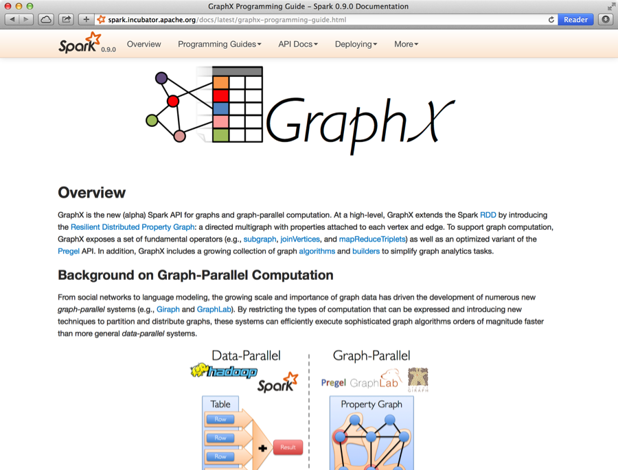
Open Source Project
Alpha release since Spark 0.9
Contributors? Python Bindings?

Slide 82
Graph Processing Systems
Apache Giraph: java Pregel implementation
GraphLab.org: C++ GraphLab implementation
NetworkX: python API for small gaphs
GraphLab Create: commercial GraphLab python framework for large graphs and ML
Gephi: graph visualization framework

Slide 83
Graph Database Technologies
Property graph data-model for storing and retrieving graph structured data.
Neo4j: popular commercial graph database
Titan: open-source distributed graph database

Slide 84
About Scala
High-level language for the Java VM
Object-oriented + functional programming
Statically typed
Comparable in speed to Java
But often no need to write types due to type inference
Interoperates with Java
Can use any Java class, inherit from it, etc; can also call Scala code from Java

Slide 85
Quick Tour
Declaring variables:
var x: Int = 7 var x = 7 // type inferred
val y = “hi” // read-only
Java equivalent:
int x = 7;
final String y = “hi”;
Functions:
def square(x: Int): Int = x*x
def min(a:Int, b:Int): Int = { if (a < b) a else b }
def announce(text: String) { println(text) }
Java equivalent:
int square(int x) { return x*x; }
void announce(String text) { System.out.println(text); }

Slide 86
Quick Tour
Generic types:
var arr = new Array[Int](8) var lst = List(1, 2, 3) // type of lst is List[Int]
Java equivalent:
int[] arr = new int[8];
List<Integer> lst = new ArrayList<Integer>(); lst.add(...)
Indexing:
arr(5) = 7
println(lst(5))
Java equivalent:
arr[5] = 7;
System.out.println(lst.get(5));

Slide 87
Quick Tour
Processing collections with functional programming:
val list = List(1, 2, 3)
list.foreach(x => println(x)) // prints 1, 2, 3 list.foreach(println) // same
list.map(x => x + 2) // => List(3, 4, 5) list.map(_ + 2) // same, with placeholder notation
list.filter(x => x % 2 == 1) // => List(1, 3) list.filter(_ % 2 == 1) // => List(1, 3)
list.reduce((x, y) => x + y) // => 6 list.reduce(_ + _) // => 6
Function expression (closure)
All of these leave the list unchanged (List is immutable)

Slide 88
Scala Closure Syntax
(x: Int) => x + 2 // full version
x => x + 2 // type inferred
_ + 2 // when each argument is used exactly once
x => { // when body is a block of code val numberToAdd = 2 x + numberToAdd }
// If closure is too long, can always pass a function def addTwo(x: Int): Int = x + 2 list.map(addTwo)
Scala allows defining a “local function” inside another function

Slide 89
Other Collection Methods
Scala collections provide many other functional methods; for example, Google for “Scala Seq”
Method on Seq[T] | Explanation
map(f: T => U): Seq[U] | Pass each element through f
flatMap(f: T => Seq[U]): Seq[U] | One-to-many map
filter(f: T => Boolean): Seq[T] | Keep elements passing f
exists(f: T => Boolean): Boolean | True if one element passes
forall(f: T => Boolean): Boolean | True if all elements pass
reduce(f: (T, T) => T): T | Merge elements using f
groupBy(f: T => K): Map[K,List[T]] | Group elements by f(element)
sortBy(f: T => K): Seq[T] | Sort elements by f(element)
. . .

